Slide 1



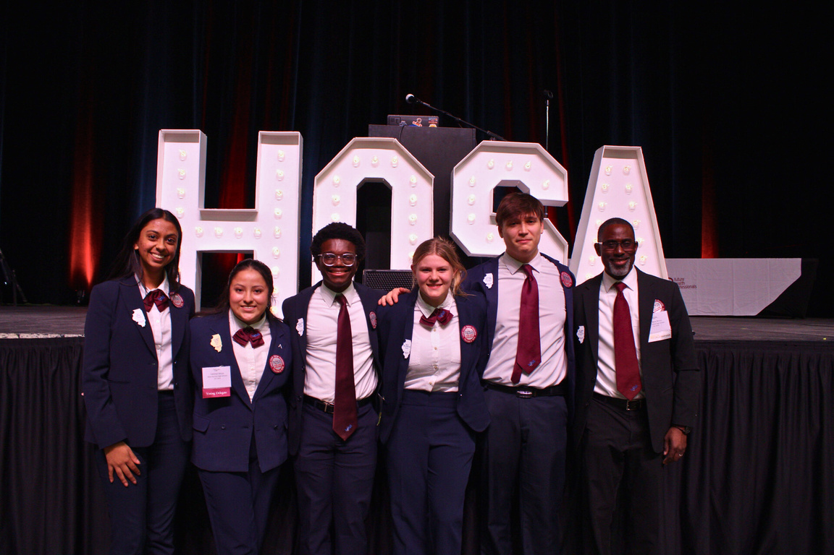
HOW TO START A
HOSA CHAPTER
WITH IL HOSA
Presentor: Luis Lopez, MBA
Email:ilhosafhp.publicrelations@gmail.com

Slide 2
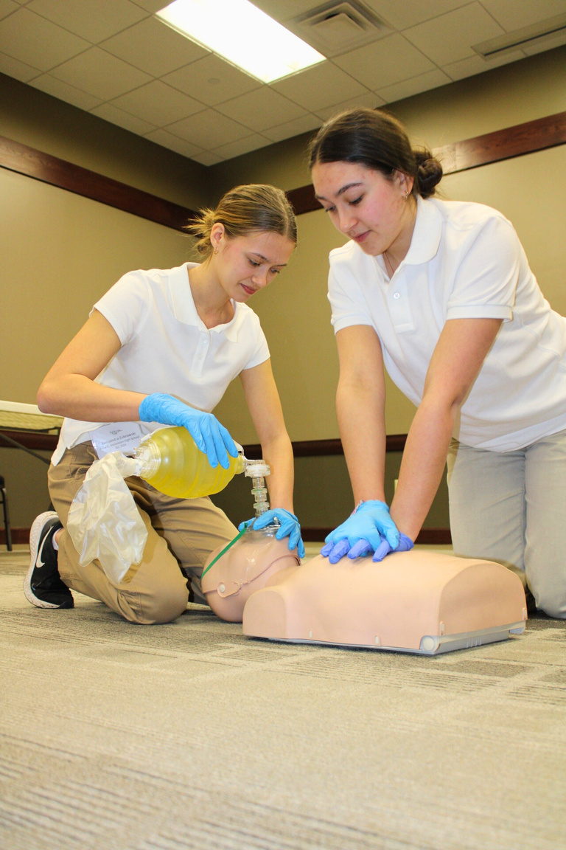

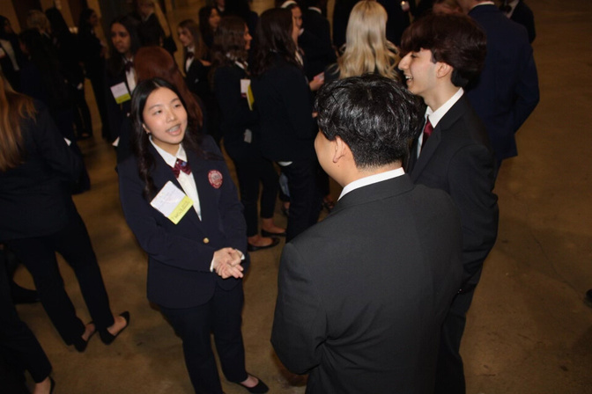


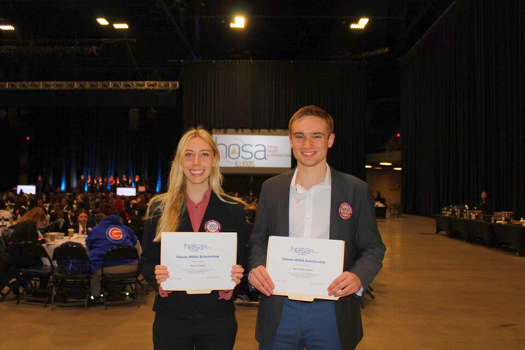



TABLE OF CONTENT
INTRODUCTION
STEPS TO START A CHAPTER
FEES
CALENDAR
Q&A

Slide 3

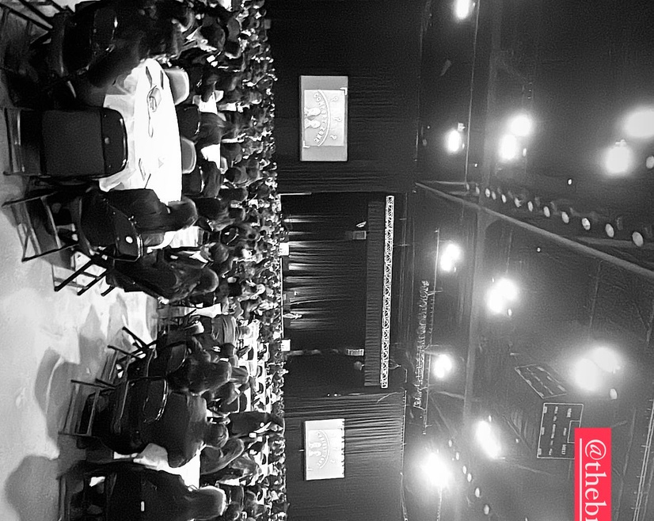


WELCOME TO ILLINOIS HOSA
HOSA-Future Health Professionals is a global, student-led organization dedicated to providing unique classroom experiences and opportunities in health professions. It focuses on leadership development and recognition for career-minded students in middle school, high school, postsecondary, and collegiate institutions.
MISSION
CORE VALUES
Empower HOSA-Future Health Professionals to become leaders in the global health community through education, collaboration, and experience.
Learn • Lead • Serve • Innovate
Visit the national hosa website to learn more

Slide 4
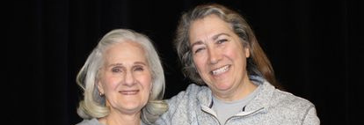
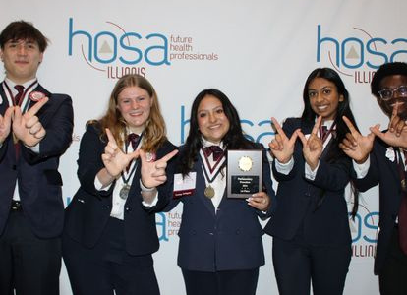


STEPS TO START A CHAPTER
STEP 1: FIND
Find a Teacher or Faculty member that would be willing to serve as your chapters advisor. While doing so find 6 other students that are interested in becoming members.
STEP 2: Complete Interest Form
Have the Advisor Complete the interest form to get started
STEP 3: DECIDE WHAT METHOD
Decide the method to organize your chapter:
  Single Chapter for all students (easiest option)
  Instructor-based Chapter
  Classroom-based Chapter

Slide 5

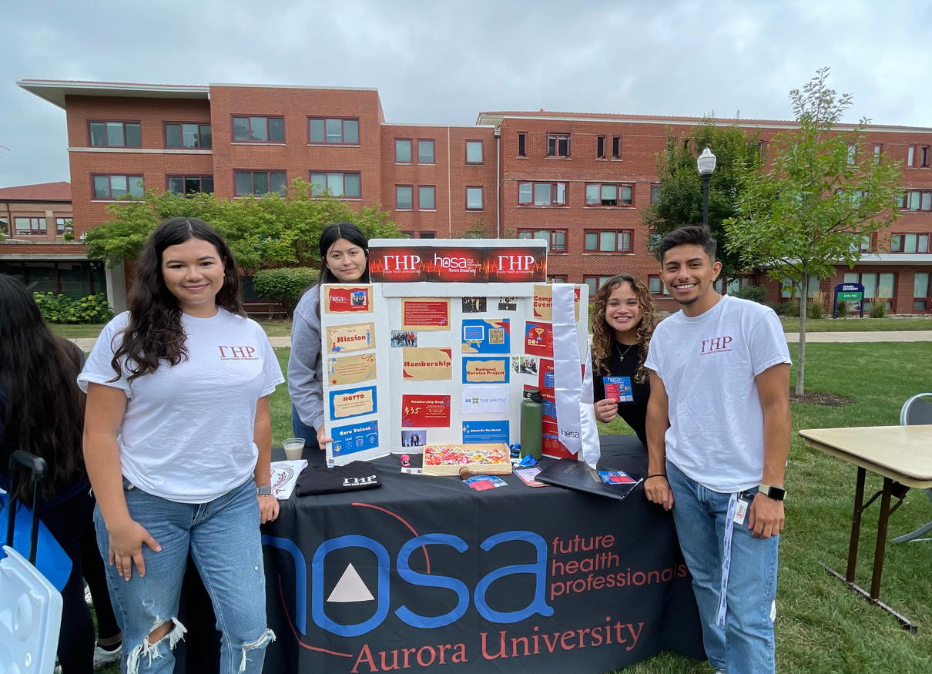

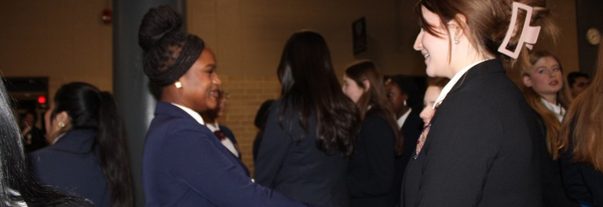
STEPS TO START A CHAPTER
STEP 4: ADOPT AND REVIEW BYLAWS
Click here for the HOSA bylaws. Review and make changes as needed to better fit your chapters needs. (Click here to view)
STEP 5: RECRUIT MEMBERS
Set up a recruitment table at your school's involvement fair. Create a social media page for your chapter to reach potential members
STEP 6: ADRESS FEES AND ESTABLISH PAYMENT PROCESSES (PER STUDENT)
State Affiliation fee: $10
International Affiliation fee: $10
Membership Registration is due by November 1st to be eligible to compete and to apply for scholarships

Slide 6



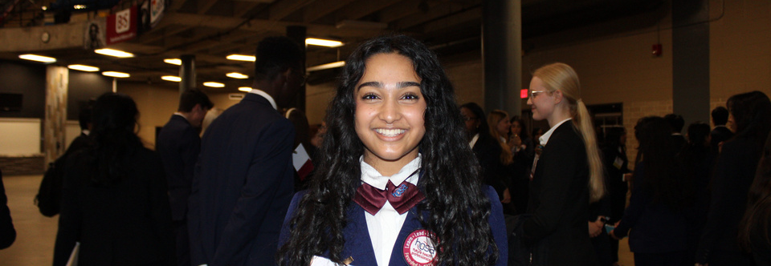
STEPS TO START A CHAPTER
STEP 7: HOST YOUR FIRST MEETING
Have members vote to approve the bylaws. Elect Chapter Officers. Consider planning fundraisers to support the activities you plan to hold. Introduce your members to HOSA and what it has to offer.
STEP 8: GET INVOLVED
  Fall Leadership Conference (FLC)
    Leadership training for chapter officers
  State Leadership Conference (SLC)
    Second Level of Competitive Events
    Election of State Officers
    Award/Recognition Ceremony
  International Leadership Conference (ILC)
    Final Level of Competitive events
    Held for all Chapters associated HOSA-Future Health Professionals
    Recognizes outstanding performance in leadership and competitions
    During the conference, members can network and have the opportunity to attend educational symposiums about current healthcare issues
    Additionally, the leadership of HOSA, Inc. and HOSA-FHP meets and elects new representatives and officers

Slide 7

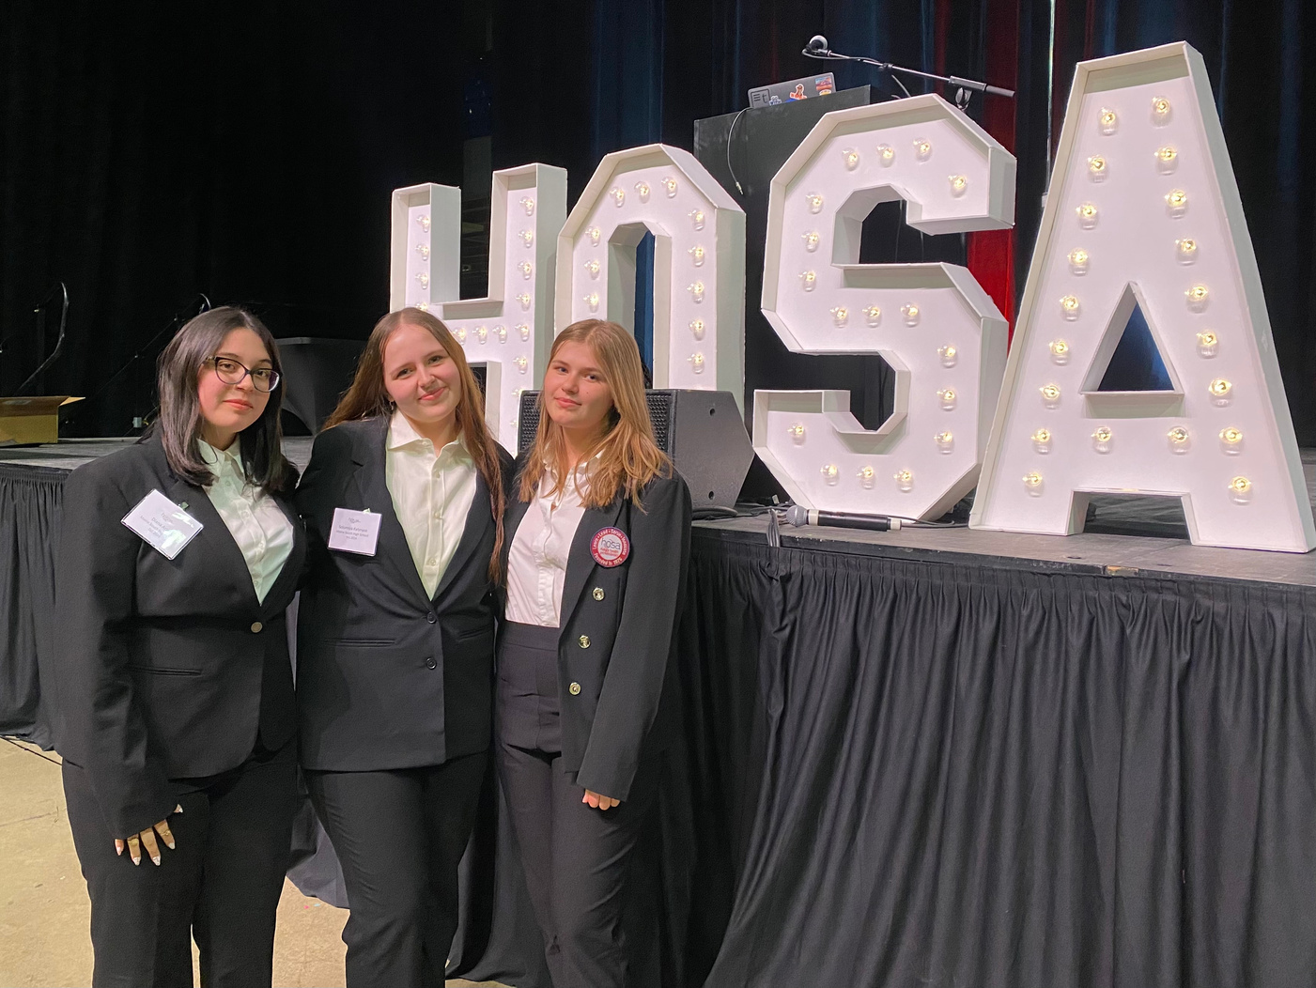
MEMBERSHIP AND FEES
  Membership Fees: $20 per person
  Fall Leadership Conference Fees: $30 per student, $50 per advisor
  State Leadership Conference: $100 per person
  International Leadership Conference: $125 per person
  Membership deadline: November 1, 2024

Slide 8

2025-26 Illinois HOSA Calendar of Events
July 28-30 - ICCCTSO State Officer workshop
September 8 - Board Meeting – President Abraham Lincoln Hotel
October 8 - Fall Leadership Conference – President Abraham Lincoln Hotel
October 15 - Affiliation deadline for HOSA 100 Club
November 1 Affiliation Deadline for 1st semester membership
*(Membership must be completed by November 1 to qualify for State
Leadership Conference)
November 3-7 National HOSA Week
2025-2026
CALENDAR
November 26 – Registration Deadline for SLC Preliminary Rounds
December 1 – 5 – SLC Preliminary Rounds
December 7 & 8 - State Officer Retreat and Board Meeting
February 1 -Deadline for State Leadership Conference Registration
January 26 - Board Meeting – President Abraham Lincoln Hotel
March 18 - 20 - State Leadership Conference - BOS Center, Springfield
*Round 1 tests to be held February 23 - 27
April 13 - Board Meeting
May 1 - Deadline for National HOSA Leadership Conference Registration
June 17 - 20 International HOSA Leadership Conference, Indianapolis, IN
Future State Leadership Conferences – Springfield, IL
March 17 - 19, 2027
March 15 - 17, 2028

Slide 9

Q&A

